Slide 1
CSE 728SEM
Conditional Generative Adversarial Nets
TingTing Wang

Slide 2
Key topics
Original GAN
Generator
Discriminator
Conditional GAN
Why
How
Type
Result
Resource
Paper
Interesting things
Useful things

Slide 3
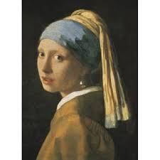
Original GAN
Consider growth up of a painter
Treat Generator as a painter
Treat Discriminator as his teacher
They “grow up” together
image comes from: link

Slide 4
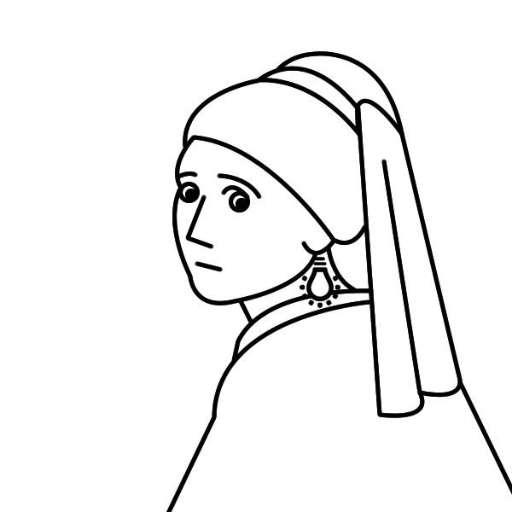
In the begining of painting
image comes from: link

Slide 5

After 5-years' learning
image comes from: link

Slide 6
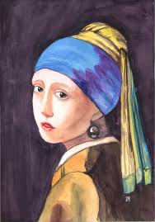
After 10-years' learning
image comes from: link

Slide 7
Finally

Slide 8
Basic Idea of the Original GAN
Oil painting generation as example
Generator
(painter)
vector
Discriminator
(teacher)
Score
high score means real, low score means fake.

Slide 9
Key topics
Original GAN
Generator
Discriminator
Conditional GAN
Why
How
Type
Result
Resource
Paper
Interesting things
Useful things

Slide 10
Why need Conditional GAN
Focus on one-to-one mapping
Original GAN can't contral the output of generator
Generate may only one kind of image
Can't generate specific class of image
image comes from: link

Slide 11
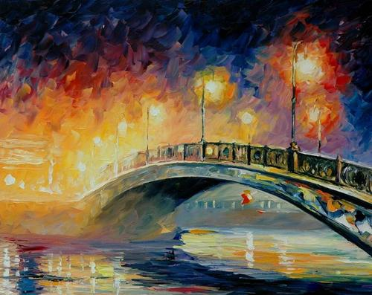
Conditional GAN - Generator
Generator
(original)
vector
vector
Generator
(conditional)
“bridge”
image comes from: link1, link2

Slide 12
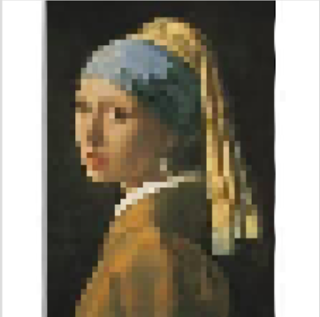
Conditional GAN - Discriminator
Discriminator
(original)
Score
high score
lowscore
high score means real image, low score means fake image
image comes from: link

Slide 13
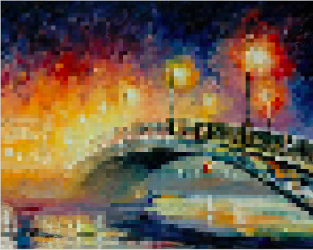
Conditional GAN - Discriminator
Discriminator
(conditional)
Score
“bridge”
high score
low score
high score means real image & match , low score means fake image / not match

Slide 14
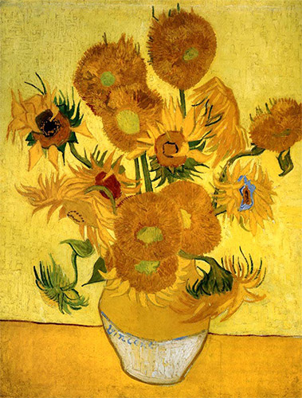
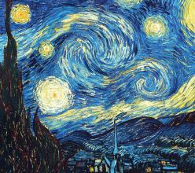
How to train conditional GAN
“girl”
“bridge”
“night”
“girl”
“girl”
“bridge”
“flower”
“night”
“night”
“flower”
“flower”
“girl”
high score
low score

Slide 15
Conditional GAN - type
Supervised conditional GAN
paired data
Unsupervised conditional GAN
unpaired data
“girl”
“bridge”

Slide 16
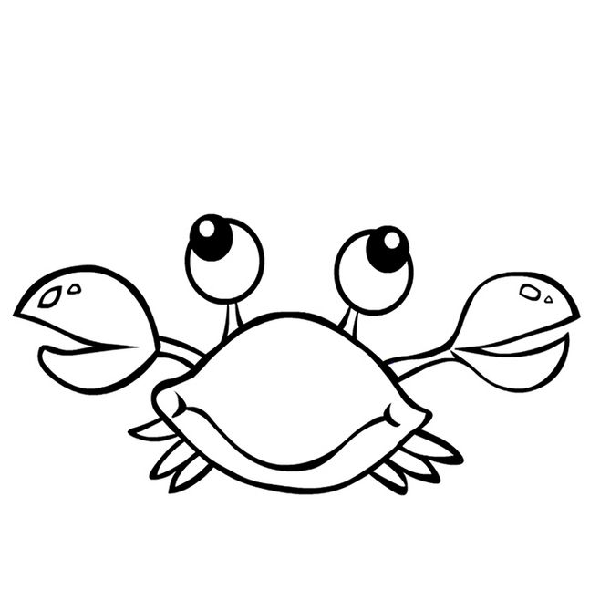
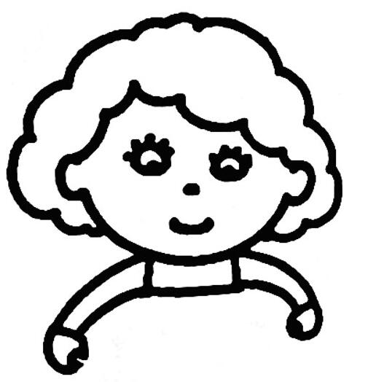
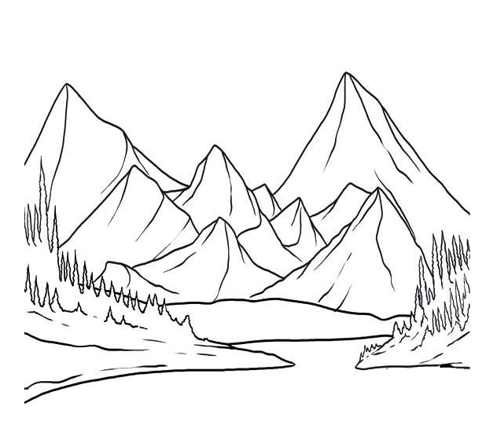
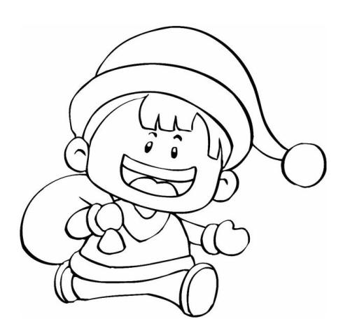
Unsupervised conditional GAN
cycleGAN
domain x
domain y
Isola, Jun-Yan Zhu, et al. “Image-to-Image Translation with Conditional Adversarial Networks.”, 2016.
Notes:
images come from google search, there are the links:
http://hbimg.b0.upaiyun.com/6cdda27911bccd3e6d9e65f940fef52b8e94e78d1c38e-lQsKaP_fw658
http://www.uzones.com/uploads/allimg/170821/2-1FR1212504-50.jpg
http://hbimg.b0.upaiyun.com/de4c947ee1058e0f7897093dce4ae3b39baa5b4d2781e-1nkpKe_fw658
http://img0.imgtn.bdimg.com/it/u=3327318490,1689220458&fm=26&gp=0.jpg

Slide 17

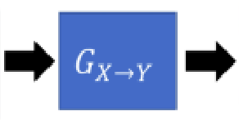
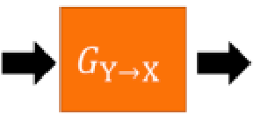
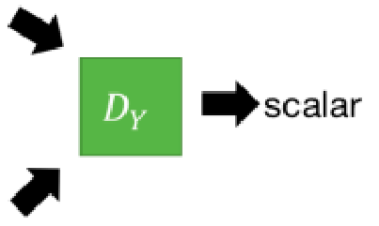
Unsupervised conditional GAN
Isola, Jun-Yan Zhu, et al. “Image-to-Image Translation with Conditional Adversarial Networks.”, 2016.
Notes:
images come from google search, there are the links:
http://hbimg.b0.upaiyun.com/6cdda27911bccd3e6d9e65f940fef52b8e94e78d1c38e-lQsKaP_fw658
http://www.uzones.com/uploads/allimg/170821/2-1FR1212504-50.jpg
http://hbimg.b0.upaiyun.com/de4c947ee1058e0f7897093dce4ae3b39baa5b4d2781e-1nkpKe_fw658
http://img0.imgtn.bdimg.com/it/u=3327318490,1689220458&fm=26&gp=0.jpg

Slide 18




Result
MNIST
Mirza, Mehdi, and Simon Osindero. “Conditional Generative Adversarial Nets.” , 2014
Notes:
images come from google search, there are the links:
http://hbimg.b0.upaiyun.com/6cdda27911bccd3e6d9e65f940fef52b8e94e78d1c38e-lQsKaP_fw658
http://www.uzones.com/uploads/allimg/170821/2-1FR1212504-50.jpg
http://hbimg.b0.upaiyun.com/de4c947ee1058e0f7897093dce4ae3b39baa5b4d2781e-1nkpKe_fw658
http://img0.imgtn.bdimg.com/it/u=3327318490,1689220458&fm=26&gp=0.jpg

Slide 19
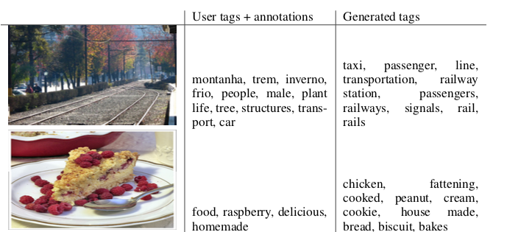
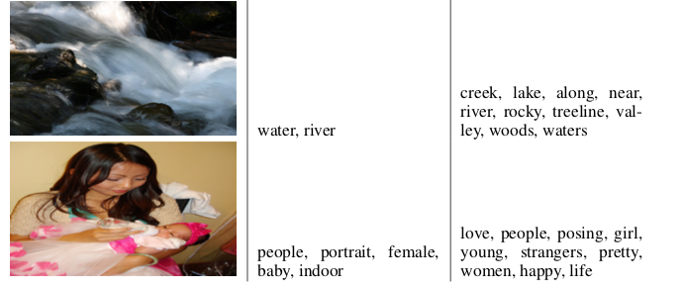
Result
MIR Flickr 25000 dataset
Images with multiple tags were repeated inside the training set each associated tag.
Mirza, Mehdi, and Simon Osindero. “Conditional Generative Adversarial Nets.” , 2014
Notes:
images come from google search, there are the links:
http://hbimg.b0.upaiyun.com/6cdda27911bccd3e6d9e65f940fef52b8e94e78d1c38e-lQsKaP_fw658
http://www.uzones.com/uploads/allimg/170821/2-1FR1212504-50.jpg
http://hbimg.b0.upaiyun.com/de4c947ee1058e0f7897093dce4ae3b39baa5b4d2781e-1nkpKe_fw658
http://img0.imgtn.bdimg.com/it/u=3327318490,1689220458&fm=26&gp=0.jpg

Slide 20
Key topics
Original GAN
Generator
Discriminator
Conditional GAN
Why
How
Type
Result
Resource
Paper
Interesting things
Useful things

Slide 21
Resource
Paper
https://arxiv.org/abs/1411.1784
Interesting things
https://affinelayer.com/pixsrv/
https://reiinakano.com/gan-playground/
https://github.com/ajbrock/Neural-Photo-Editor/
Useful thing
https://pytorch.org/tutorials/beginner/dcgan_faces_tutorial.html
https://www.tensorflow.org/beta/tutorials/generative/style_transfer
http://www1.idc.ac.il/toky/seminarIP-18/Presentations/10b_raaz.pdf
http://speech.ee.ntu.edu.tw/~tlkagk/courses/MLDS_2018/Lecture/fGAN.pdf

Slide 22
Thank You !

